Slide 1






ICEBERG: Imagery Cyberinfrastructure and Extensible Building Blocks to Enhance Research in the Geosciences
Heather Lynch (Department of Ecology & Evolution/Institute for Advanced Computational Science, Stony Brook University)
Shantenu Jha (Department of Electrical and Computer Engineering, Rutgers University)
Vena Chu (Department of Geography, University of California Santa Barbara)
Mike Willis (Department of Geological Sciences, University of Colorado Boulder)
Mark Salvatore (Department of Physics and Astronomy, Northern Arizona University)

Slide 2
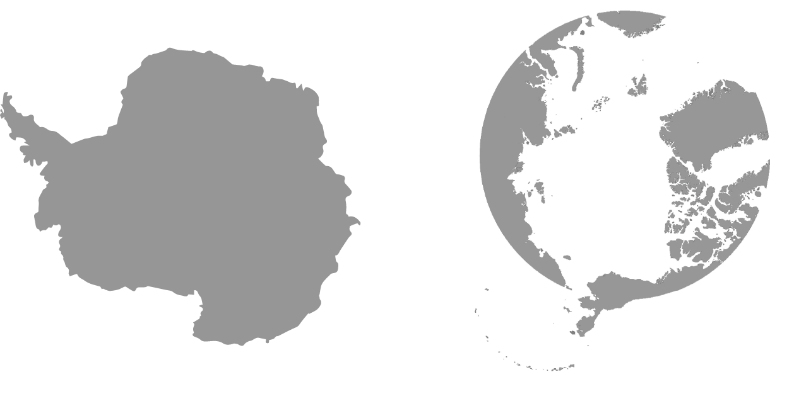
Opportunity
^
Science Challenge:
Petabytes of high-resolution satellite imagery
New analytical tools (e.g., machine learning)
High performance and distributed computing resources
+
+
=
Revolution in imagery-enabled science
Rapid rise in the use of sub-meter spatial resolution imagery for polar science
Many pilot demonstrations but few “at scale”
What’s the barrier to scaling up early successes in imagery-enabled science? Barriers to the flow of data, limited experience with HPDC systems, reliant on commercial software that is difficult to parallelize due to licensing issue
The research objective of this project is to understand the biological, geological, and hydrological functioning of the polar regions at spatial scales heretofore beyond the reach of individual PIs, and to develop tools for imagery-enabled science that can be applied globally.

Slide 3
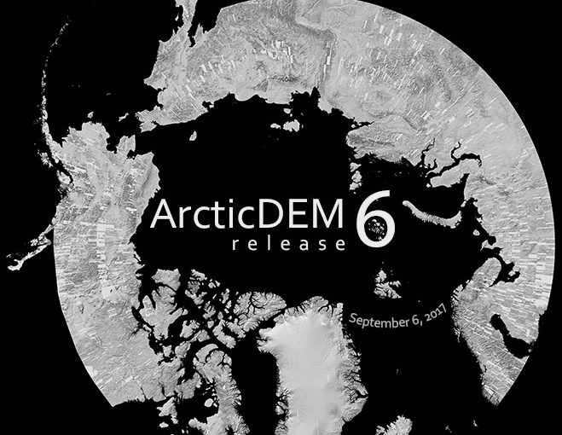
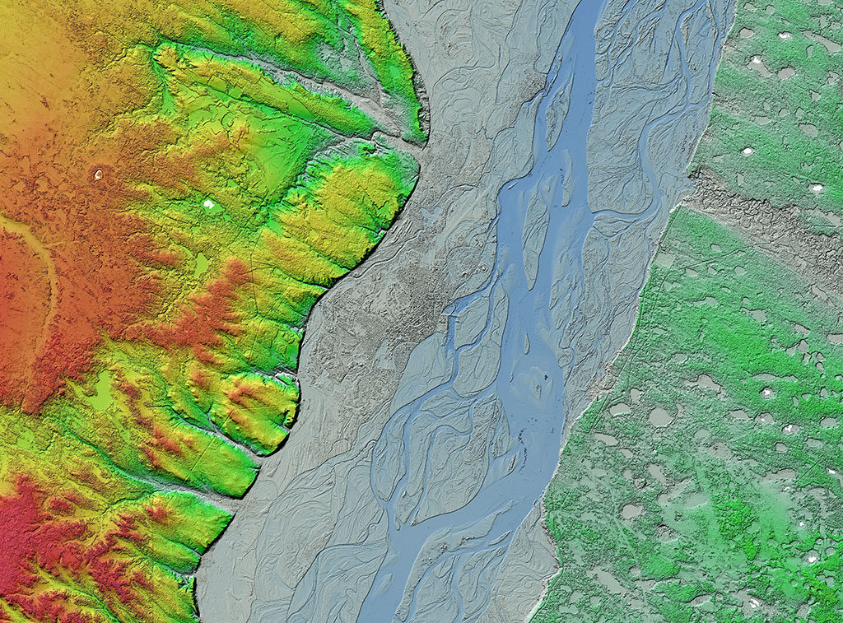
Yakutsk on the Lena River, Siberia
High resolution terrain data is now available for 97.4% of the Arctic. (Source: PGC)
Images and figures courtesy of the Polar Geospatial Center

Slide 4
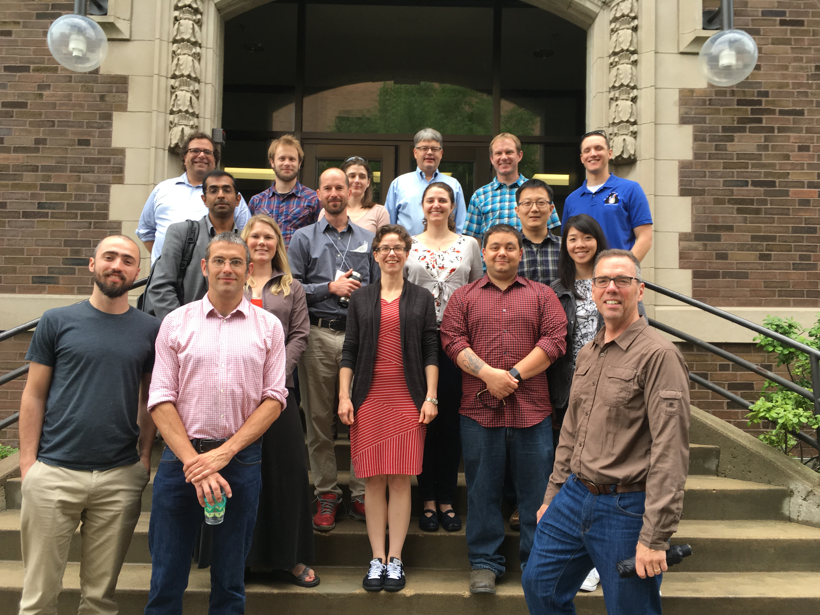

‘horizon scan’ style discussion to identify the most critical bottlenecks (current or near-term) for the effective use of polar imagery across the polar science community
Lessons learned*:
(1) Imagery transfer a major barrier to large-scale analysis
(2) Many analysis methods reliant on proprietary software difficult (or too expensive) to parallelize
(3) Many boutique solutions but few “production grade” pipelines for scaling up techniques demonstrated in smaller pilot projects
(4) Entry barrier to moving to HPC too high for many in the community
* Shared themes with the Pangeo presentation Sept. 28

Slide 5
Examples of imagery-enabled geosciences to be extended by the proposed CI development.
Identifying photosynthetic microbial colonies in the McMurdo Dry Valleys using Worldview-based Normalized Difference Vegetation Index (NDVI).

Slide 6
Examples of imagery-enabled geosciences to be extended by the proposed CI development.
Automated detection of pack-ice seals in satellite imagery using deep learning (TensorFlow).

Slide 7
Examples of imagery-enabled geosciences to be extended by the proposed CI development.
Moulin discharge in Greenland classified with high-resolution satellite imagery.

Slide 8
Examples of imagery-enabled geosciences to be extended by the proposed CI development.
Volume changes from the Vavilov Ice Cap calculated by co-registration and differencing of DEMs.

Slide 9
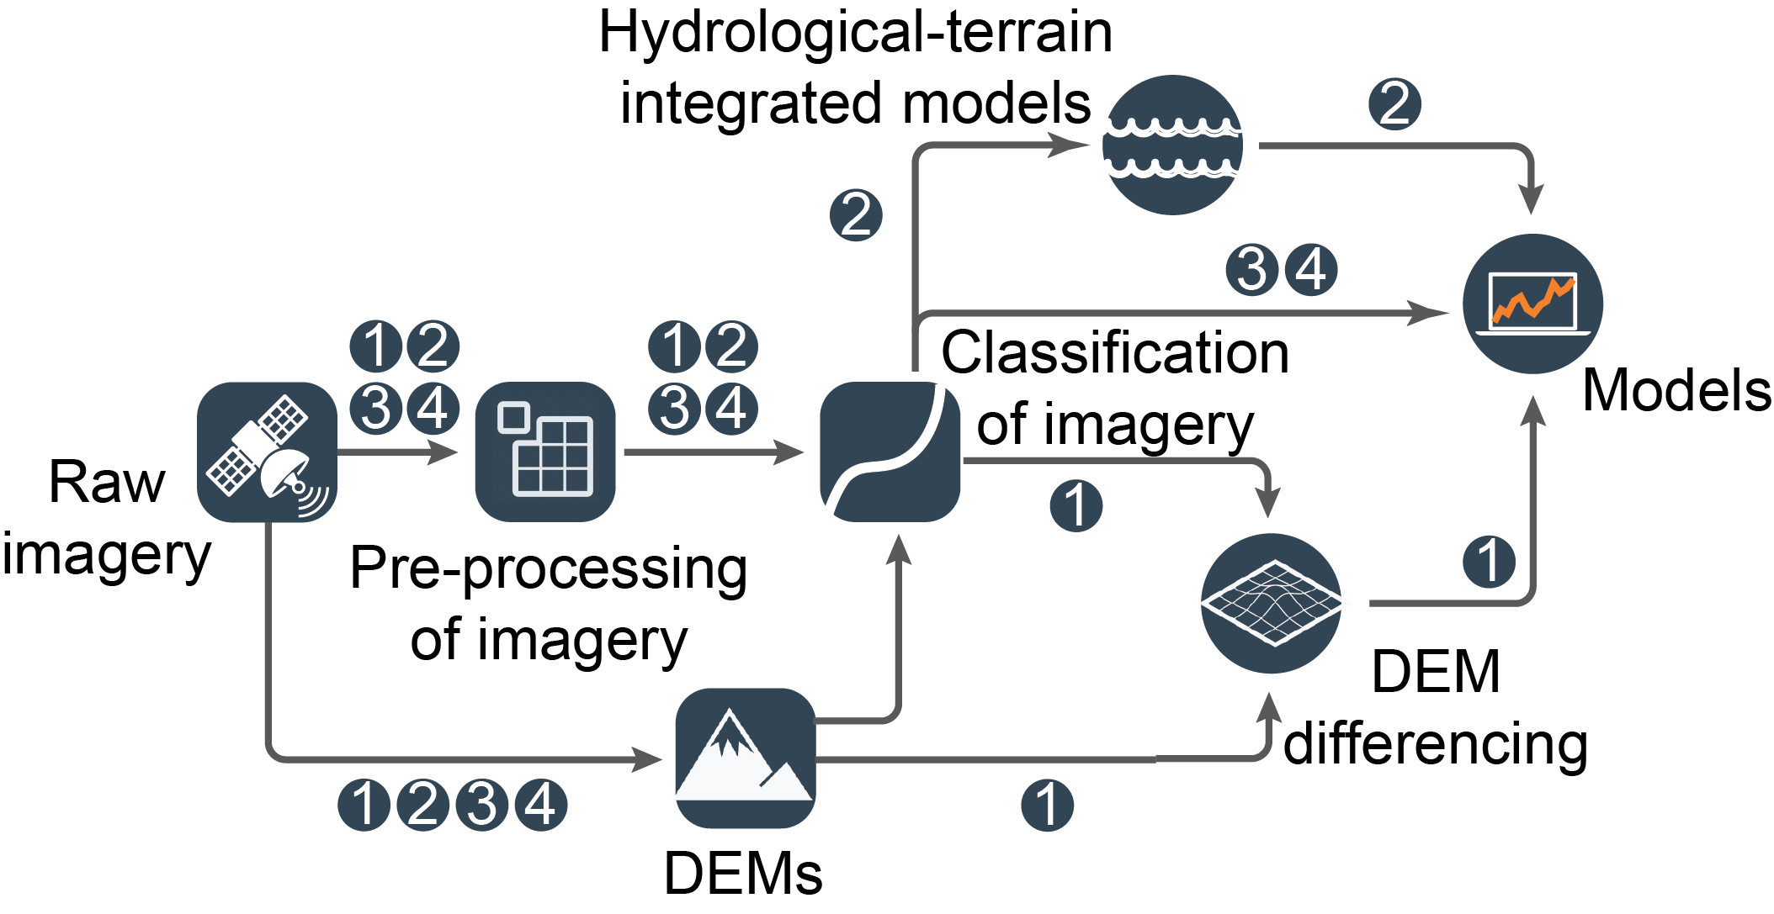
Create pipelines for imagery processing and feature extraction that leverages shared functionality.

